Slide 1
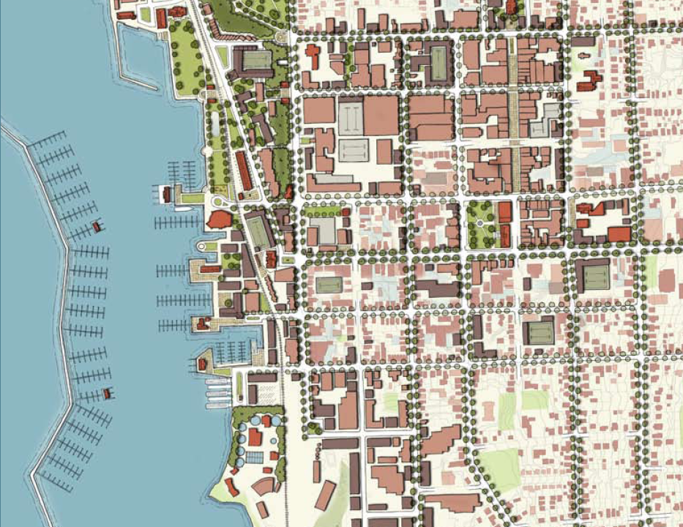
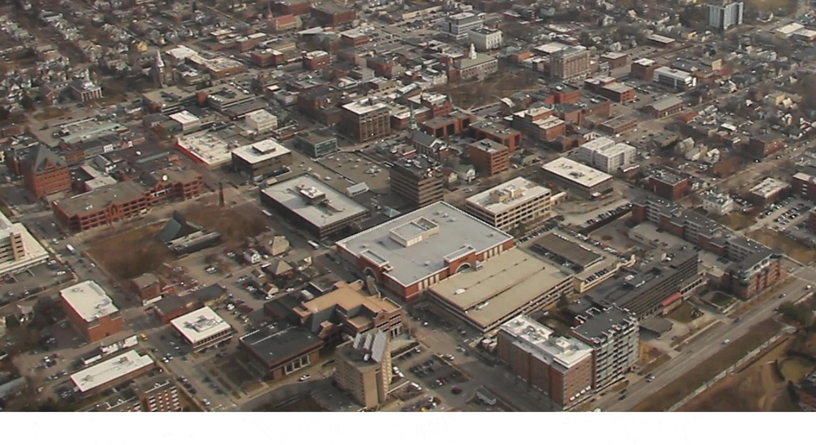
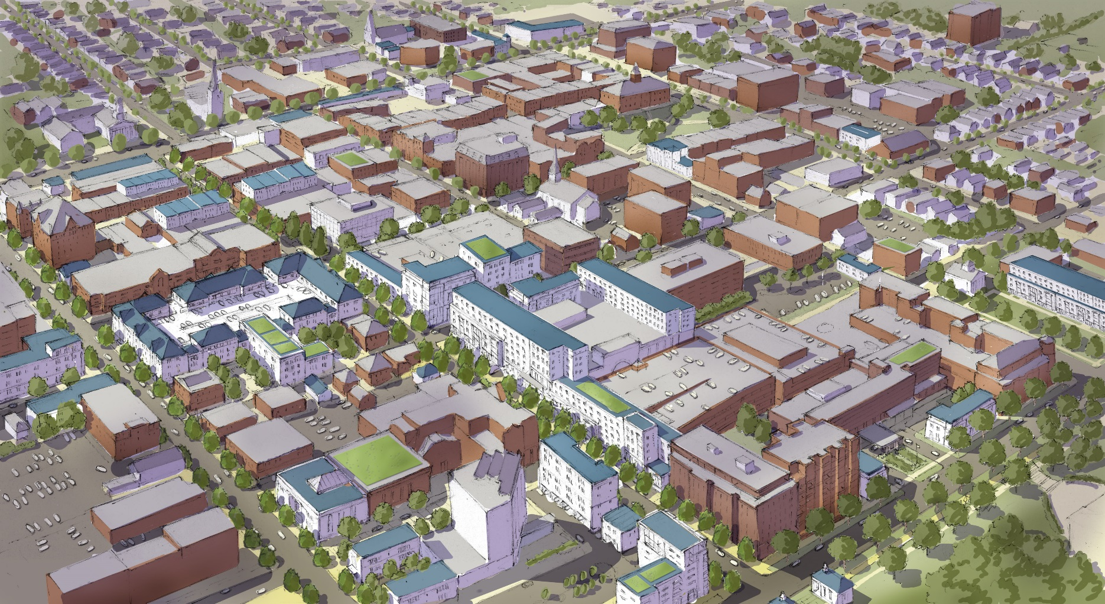
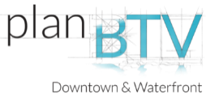
Re-Imagining the
Burlington Town Center
LAND USES

Slide 2
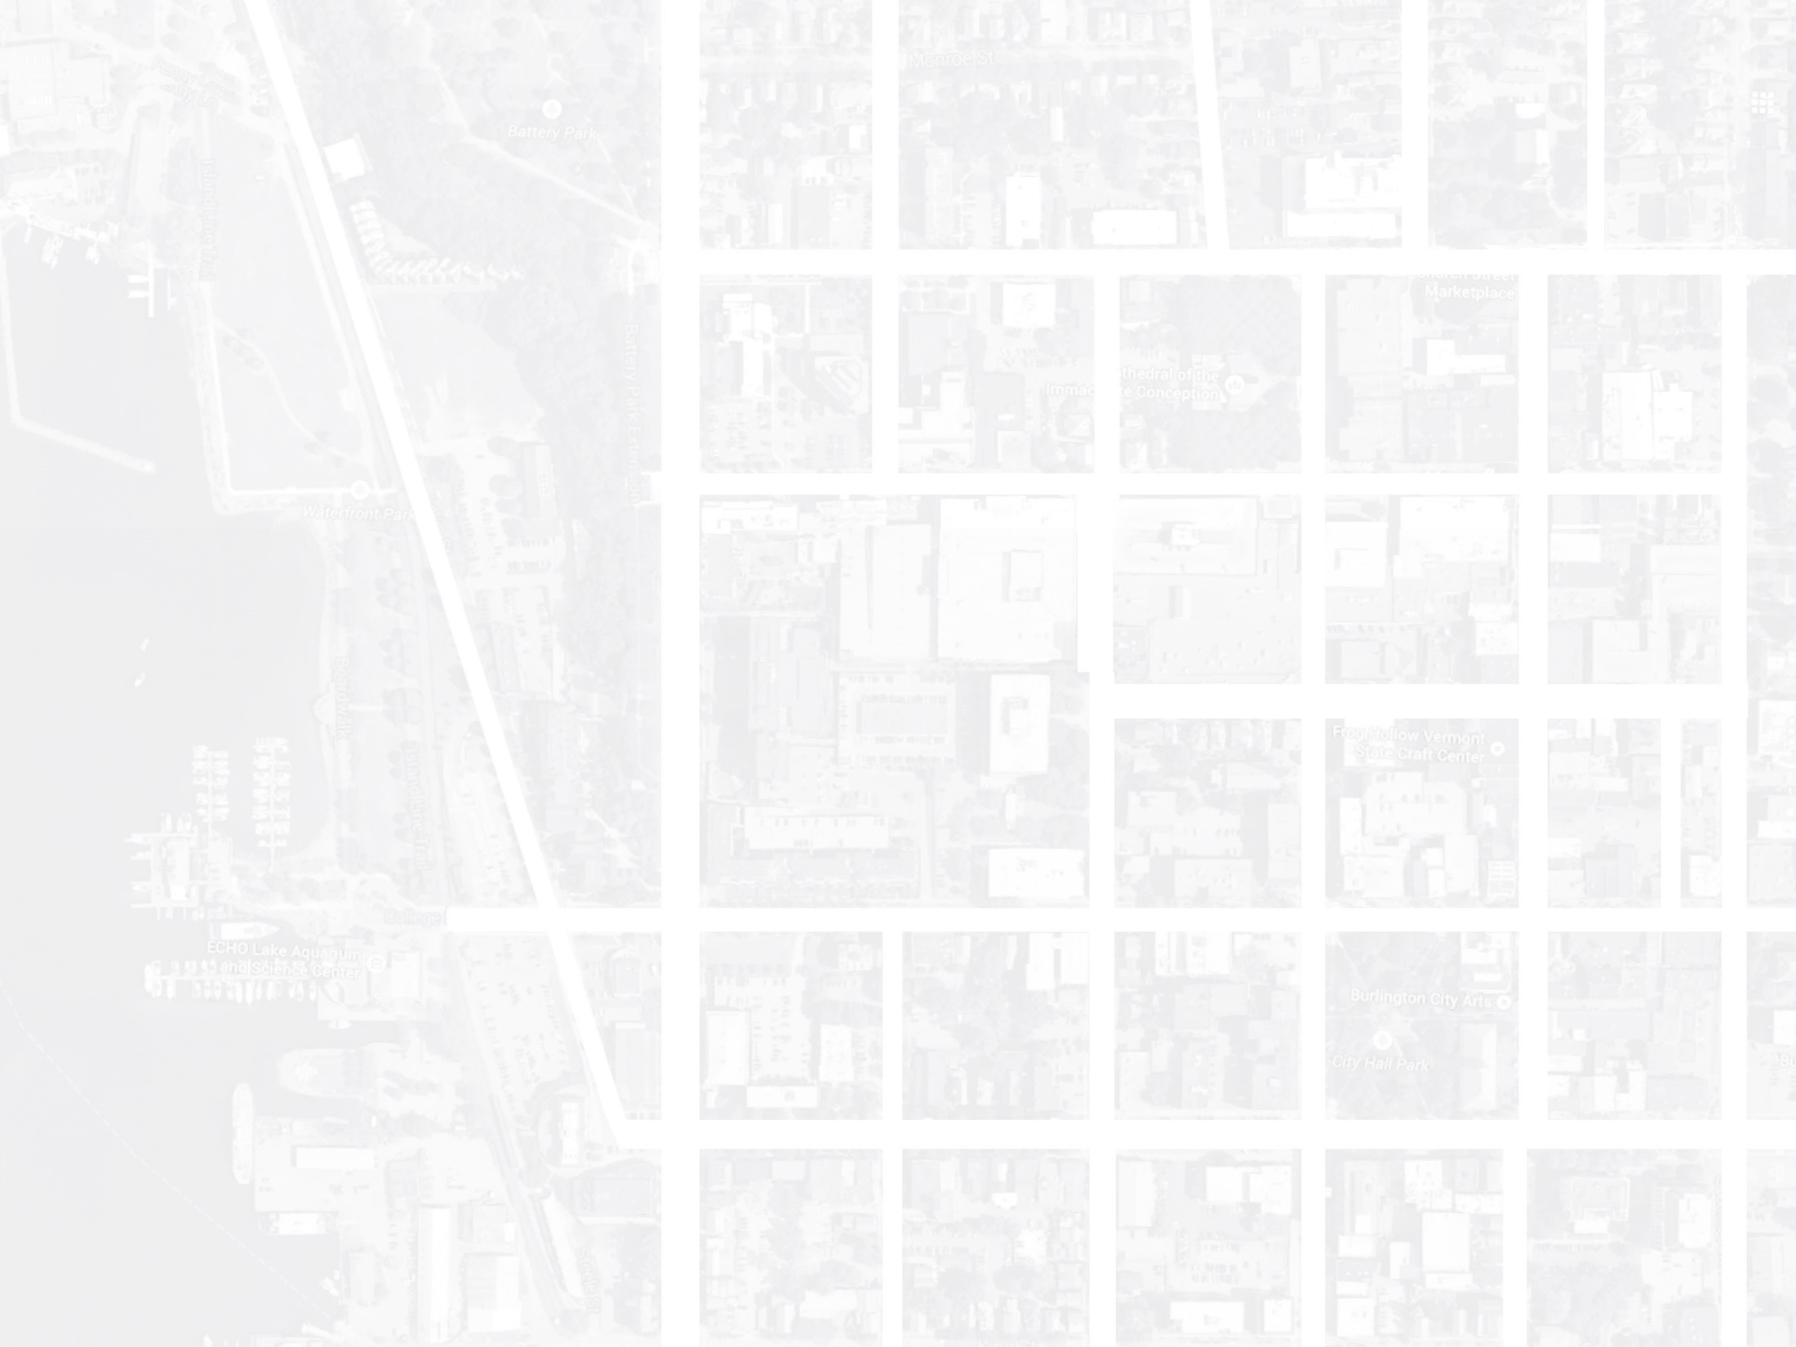
SUN STUDIES

Slide 3
EXISTING
PROPOSED
SUN STUDY – VERNAL EQUINOX

Slide 4
EXISTING
PROPOSED
SUN STUDY – SUMMER SOLSTICE

Slide 5
EXISTING
PROPOSED
SUN STUDY – WINTER SOLSTICE

