Slide 1
Notes:
1. Introductions: Belan welcomes the committee and starts introductions:
- Belan is REIB's Strategy and Innovation Manager – was lead on developing this plan and is taking a leading role in implementing this work. Leave of absence from October 2022 to May 2023
- Katie is one of REIB's Racial Equity Facilitators but also play a role in the strategic planning and engagement – She contributes to the work of the REIB by co-constructing and facilitating the City-wide REIB racial equity workshop, implementing the REIB's Strategic Road Map, creating racial equity courses and educational tools, building relationships between and collaborating with local organizations and community groups, and by analyzing and creating policies in support of a more equitable workplace and City-wide culture. She has a background in African and Black diasporan history. She received her MA in African history at Michigan State during which time she lived and researched in East and West Africa for several years. Katie has experience teaching K-12 and undergraduate students, as well.
and she has experience teaching K-12 and undergraduate students.... and contributes to this work through...

Slide 2
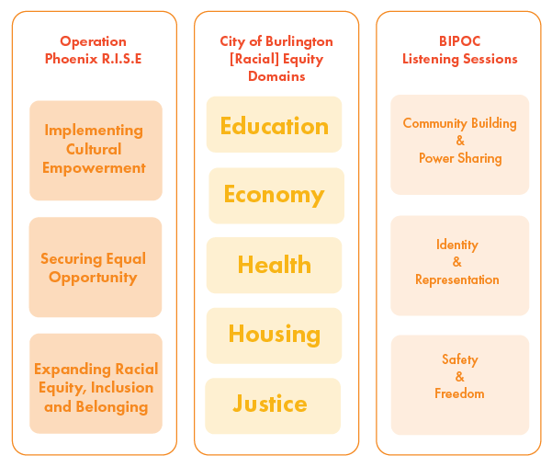
Roadmap Refresher
Notes:
ROADMAP REFRESHER: Director Green and I began this work last year with the support of Greyscale Collaborative.
Based in the principles of VRJA’s Operation Phoenix R.I.S.E from 2020
Framed by five [Racial] Equity Domains (rooted in the Social Determinants of Health)
Goals, data, and updates will be grouped in these domains
Guided by the BIPOC voices
preliminarily from the BIPOC Listening Sessions
Continued BIPOC community engagement will be a standard

Slide 3
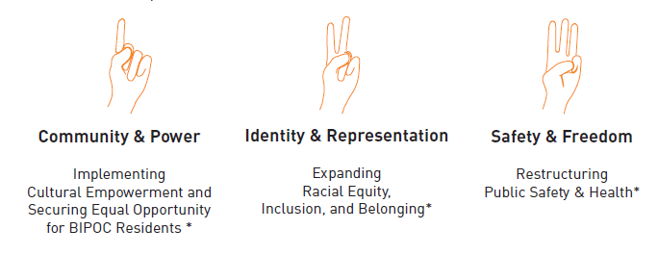
Grounding Values
Notes:
The 3 Grounding Values inform the goals, strategies, and actions identified in the Roadmap
Based on the BIPOC Racial Equity Listening Sessions
See page 25 in roadmap for details

Slide 4
Vision, Challenges, Goals and Metrics
Notes:
Making progress towards Goal 3, in collaboration with CEDO, using BIPOC Procurement trategies
BA
Based on inputs from the BIPOC listening Sessions
Preliminary goals and challenges for each [Racial] Equity Domain
Each [Racial] Equity Domain is sub-sectioned into:
1. Vision
2. Challenges
3. Metrics
4. Goals
5. National Models (case studies)

Slide 5
Where are we now?:
Domain Working Groups
Metrics and Data Infrastructure
Engagement
Notes:
Our progress is generally delayed as a result of:
Belan's sabbatical – she was leading this project
REIB Transition and staff changes
While the roadmap has been build out, there is still a body of work left to do in 1) defining and specifying the goals and 2) creating the infrastructure to work towards those goals.
Approach currently: Adding detail and creating an implementation approach (including classifying goals,
Building relationships with the experts and key players inside and outside of the City for each domains
Develop metrics and infrastructure to measure this work – working with Planning to do this (maybe hiring a Data Analyst)
Engagement Strategy – making sure the right people and the community at large are moving through this together and with us (socials, re-engagement, bringing in community partners who already do this work, working with the NPA’s and other civic engagement efforts)

Slide 6
Next Steps
Implementation Timeline
Structure for communicating progress
Hiring new REIB Director
Hiring new department staff
Expanding the REIB department's capacity for implementing the Strategic Road Map
Notes:
With new employees and resource capacity:
Develop an updated timeline for implementing Strategic Road Map to present to City Council and Greater Burlington community
Develop schedule and structure for communicating progress to City Council and Greater Burlington community

Slide 7
Questions

