Slide 1
Burlington Aging Council Program Policy Scoping Rapid Assessment
Presented by:
Kelly Baldwin
Megan Hoke
Anna McMahon
Elena Roig
Notes:
Line spacing + Page numbers

Slide 2
Introduction
This Photo by Unknown Author is licensed under CC BY-NC-ND
Goal: Assess what has been developed in other communities, scalable to Burlington, that should be investigated to address family caregiving and support, food security, social inclusion and civic engagement, and racial equity. ​
Methods:
Conducted interviews with members of the Aging Council, as well as community members​
Identified resources for community projects that promote & support healthy aging & age-friendly neighborhoods & communities​
Recommendations to the Council​

Slide 3
Family Caregiving and Support
01

Slide 4
Gaps
Education
Respite
Affordability

Slide 5
Existing Resources
One Adult Day Center offered
Independent living spaces that are staffed
Limited educational resources
Private at-home (for-profit) organizations

Slide 6
What Others Offer
A greater variety of at-home care options
Alternative costs for adult day centers
Direct sources to free educational opportunities

Slide 7
Notable Projects
Senior Library Events
Penacook Village Fund
Project CARE
Bryan, TX
National
Ashville, NC

Slide 8
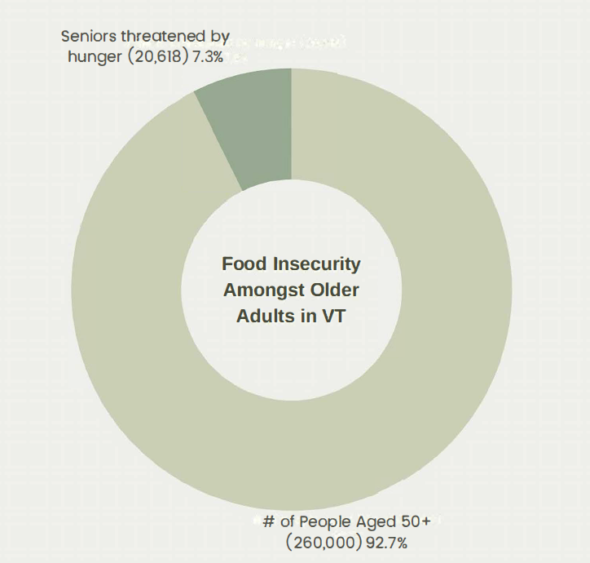
Food Security
02
Common issues faced by food insecure older adults:
Isolation & loneliness
Lack of transportation & stable housing
More likely to consume fewer calories and lower quantities of key nutrients
Food insecurity can contribute to chronic health conditions like Type 2 diabetes, high blood pressure, heart disease and obesity.
Figure 1. Food Insecurity Amongst Older Adults in Vermont. Compiled from Age Well and SeniorLiving.org statistics

Slide 9
Food Security on a National Scale
​ | Burlington, VT​ | Portland, ME​ | Burlington, NC​
Community Resource Guide​ | Aging in Vermont 2020 Resource Guide & Directory​ | AARP Age-Friendly Resource Guide​ | Community Resource Assistance Guide Alamance County, NC​ Alamance Eldercare – provides resources to older adults​
Food Shelves / Pantries​ | 1 Foodbank​ | 6 food pantries in the county​ | 8 organizations offering food & meals​
Deliveries​ | Meals on Wheels​​ Stay at Home Program through FC​ | Meals on Wheels​ Local food shelves/pantries​ | Meals on Wheels​​ Local food shelves/pantries​
Community Centers​ | ​Heinsberg Community Senior Center Pathways Vermont O.N.E. Community Center Robert Miller Community & Recreation Center Sara Holbrook Community Center – geared towards children & families, but have food pantry​ | ​East End Community Center Peaks Island Community Center Reiche Community Center Riverton Community Center​ | Healing Station Community Center​
Other ​ | Age Well, Hunger Free Vermont Crop Cash through NOFA VT – seniors can triple 3SquaresVTbenefits at farmers markets​ | Maine Senior Farm Share – free produce for eligible seniors​ | Cares NC Program - includes food assistance​ Alamance County Health Department ​

Slide 10
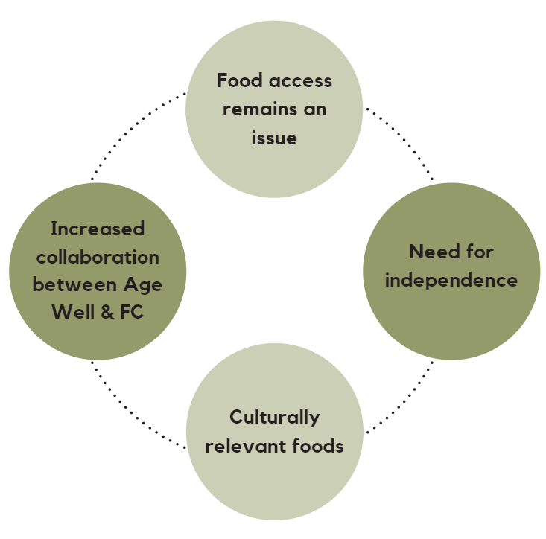
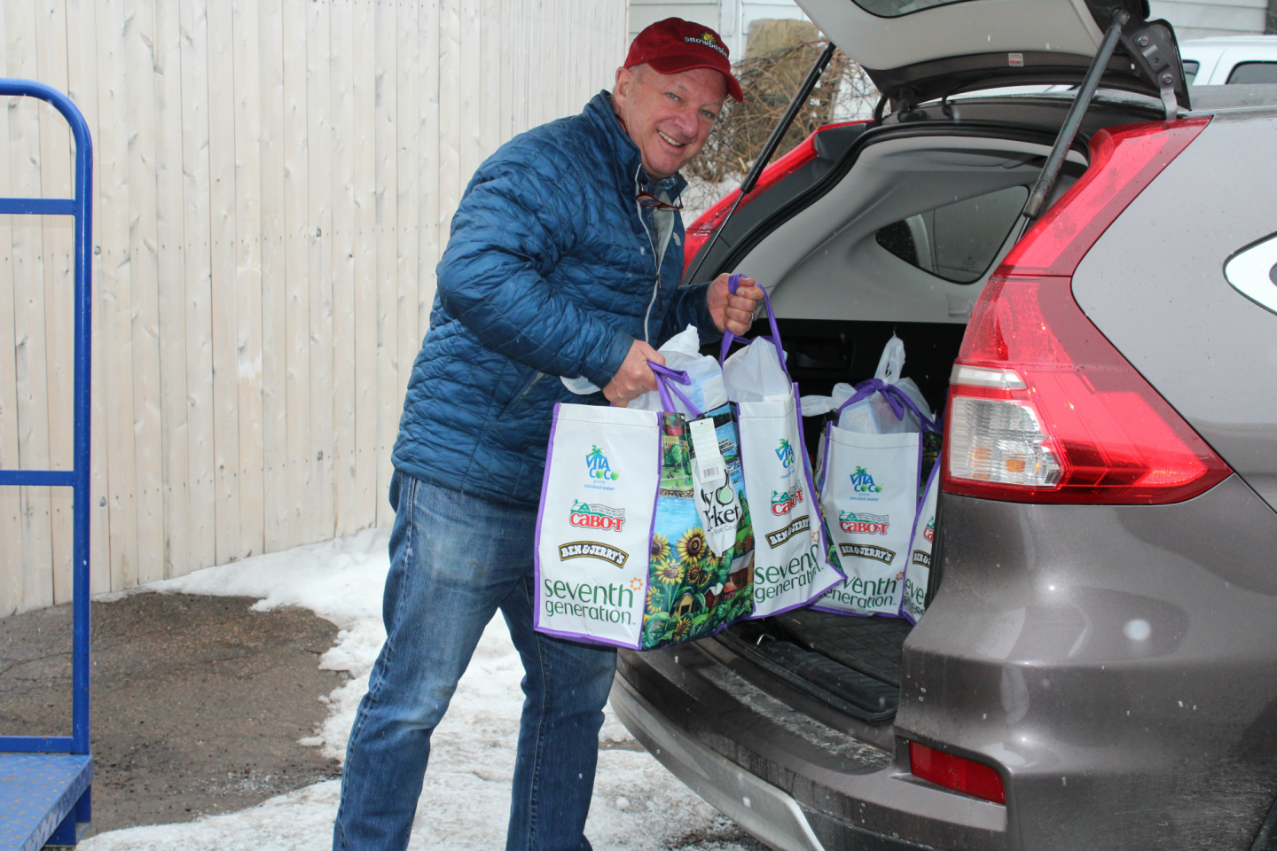
Key Takeaways for food security

Slide 11
Racial Equity and Social Inclusion
03

Slide 12
Areas of Need
Transportation
Access to information
Proper translation
Increased access to programs

Slide 13
Community Based
Participatory
Research (CBPR)
model
Build on existing strengths and resources
Facilitate collaborative partnerships
Promotes co-learning in a cyclical iterative process

Slide 14
Social Inclusion & Civic Engagement​
04

Slide 15
Programmatic Opportunities
Neighbor Rides (United Way); Grand Friends (UVM Center on Aging); Senior Companion Program (various)
RSVP (Retired & Senior Volunteer Program; United Way)
Surrey Intercultural Seniors Social Inclusion Partnership (SISSIP; Surrey, British Columbia)
Emphasis on telephone-based programming, technology skill-building
ENCorps Leadership Corps (via University of Maine Center on Aging & Maine Community Foundation)
Boomer Reporting Corps (special initiative via ENCorps)

